Slide 1

Session Evaluations
We want to hear from you!
Open the app.
Locate your chosen session.
Click “Session Evaluation.”
Be sure to click “Finish.” It only takes a few seconds!

Slide 2
Gene Kim
Founder, IT Revolution

Slide 3

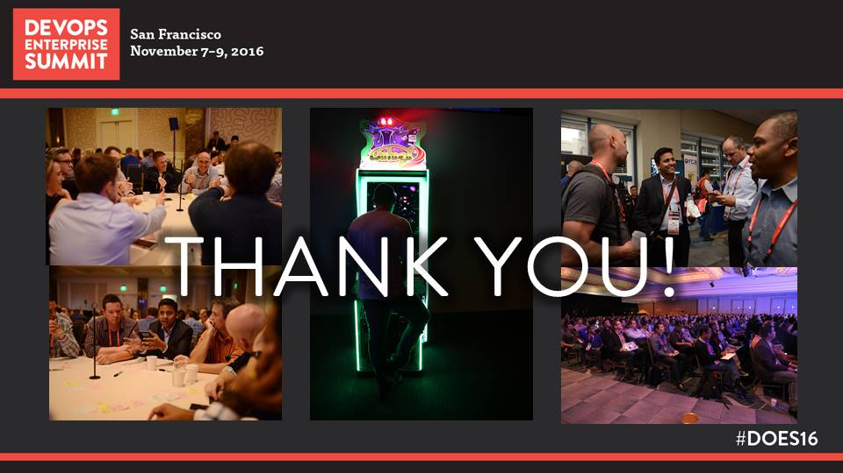
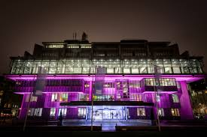

See you in 2017
DOES17
June 5 & 6, 2017
QEII Centre, London
November 13–15, 2017
Hilton Union Square,
San Francisco
Notes:
QEII and Union Square photos

Slide 4
See you in 2017
DOES17
June 5 & 6, 2017
QEII Centre, London
November 13–15, 2017
Hilton Union Square,
San Francisco
Notes:
QEII and Union Square photos

Slide 5
Gene Kim & Steve Brodie
Founder, IT Revolution | CEO, Electric Cloud

Slide 6
Session Evaluations
We want to hear from you!
Open the app.
Locate your chosen session.
Click “Session Evaluation.”
Be sure to click “Finish.” It only takes a few seconds!

Slide 7
Gene Kim & Sam Fell
Founder, IT Revolution | VP, Electric Cloud

Slide 8
Session Evaluations
We want to hear from you!
Open the app.
Locate your chosen session.
Click “Session Evaluation.”
Be sure to click “Finish.” It only takes a few seconds!

Slide 9
Rosalind Radcliffe & Rich Jackson
Distinguished Engineer, Chief Architect for Devops, IBM
Principal Systems Engineer, Walmart Technology

Slide 10
Session Evaluations
We want to hear from you!
Open the app.
Locate your chosen session.
Click “Session Evaluation.”
Be sure to click “Finish.” It only takes a few seconds!

Slide 11
Pauly Comtois
VP Devops, Hearst

Slide 12
Session Evaluations
We want to hear from you!
Open the app.
Locate your chosen session.
Click “Session Evaluation.”
Be sure to click “Finish.” It only takes a few seconds!

Slide 13
Dominica DeGrandis
Director, Training & Coaching, LeanKit

Slide 14
Session Evaluations
We want to hear from you!
Open the app.
Locate your chosen session.
Click “Session Evaluation.”
Be sure to click “Finish.” It only takes a few seconds!

Slide 15
Michael Nygard
VP, Customer Solutions, Cognitect Inc.

Slide 16
Session Evaluations
We want to hear from you!
Open the app.
Locate your chosen session.
Click “Session Evaluation.”
Be sure to click “Finish.” It only takes a few seconds!

Slide 17
Adrian Cockcroft
Amazon Web Services

Slide 18
Session Evaluations
We want to hear from you!
Open the app.
Locate your chosen session.
Click “Session Evaluation.”
Be sure to click “Finish.” It only takes a few seconds!

Slide 19
Jason Cox
Director, Systems Engineering, The Walt Disney Company

Slide 20
Session Evaluations
We want to hear from you!
Open the app.
Locate your chosen session.
Click “Session Evaluation.”
Be sure to click “Finish.” It only takes a few seconds!

Slide 21
Gene Kim
Founder, IT Revolution

Slide 22
Session Evaluations
We want to hear from you!
Open the app.
Locate your chosen session.
Click “Session Evaluation.”
Be sure to click “Finish.” It only takes a few seconds!

